Slide 1
Smart Temperature System
Made by:
Divesh
Inderpal
Jasmeet

Slide 2
Why do we need it?
In recent times, weather around the world has become unpredictable and extreme due to which heating and cooling appliances are used more frequently.
But, in the fast pace of life people usually forget to turn off the appliances.
So what we need is a system that automatically triggers the heating/cooling system to keep the house temperature at a normal level

Slide 3
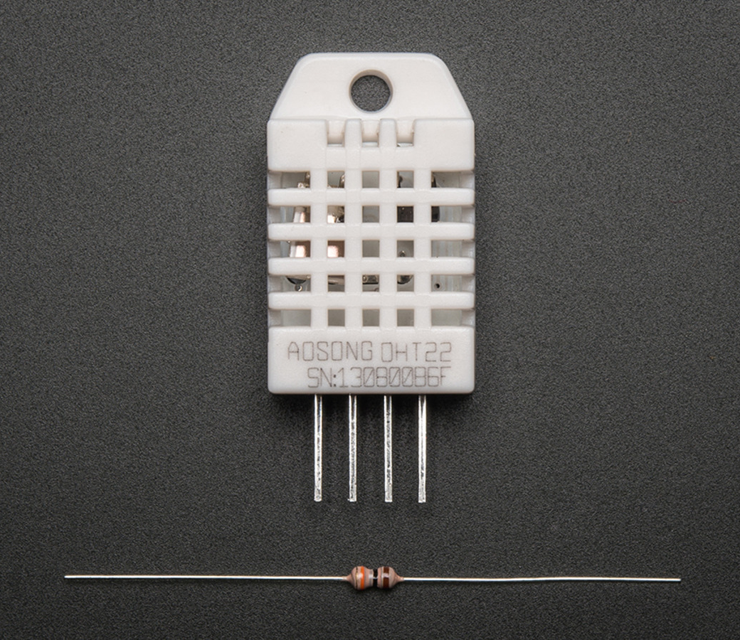
Sensing
In this system, there will be sensing of the outdoor and indoor temperatures level for further taking an action. We will be using DHT22 temperature and humidity sensor.

Slide 4
Thinking
Sensor will compare the temperatures recorded to reach a middle temperature value that is neither too hot or cold.
In this system will compare the datasets of the outside and inside temperatures so that the appliances get triggers.

Slide 5
Act
After the comparison of the two datasets the system will act and make the appliance turn on and off.
This act will be automated and making a smart living system.

Slide 6

Demonstration of the Prototype

Slide 7
Group Members Roles
Name | Role
Jasmeet Singh | Developer
Divesh | Project Researcher
Inderpal Kaur | Data handler and tester

Slide 8
Trello Board
https://trello.com/b/tA2HxAn2/smart-temperature-system

Slide 9
Burndown Chart

Slide 10
Code and data
Link of the code : https://github.com/jasmeetsi4/Smart-Temperature-System/blob/master/temp.ino
Link of the data collected: https://github.com/jasmeetsi4/Smart-Temperature-System/blob/master/MLOG01.CSV

Slide 11
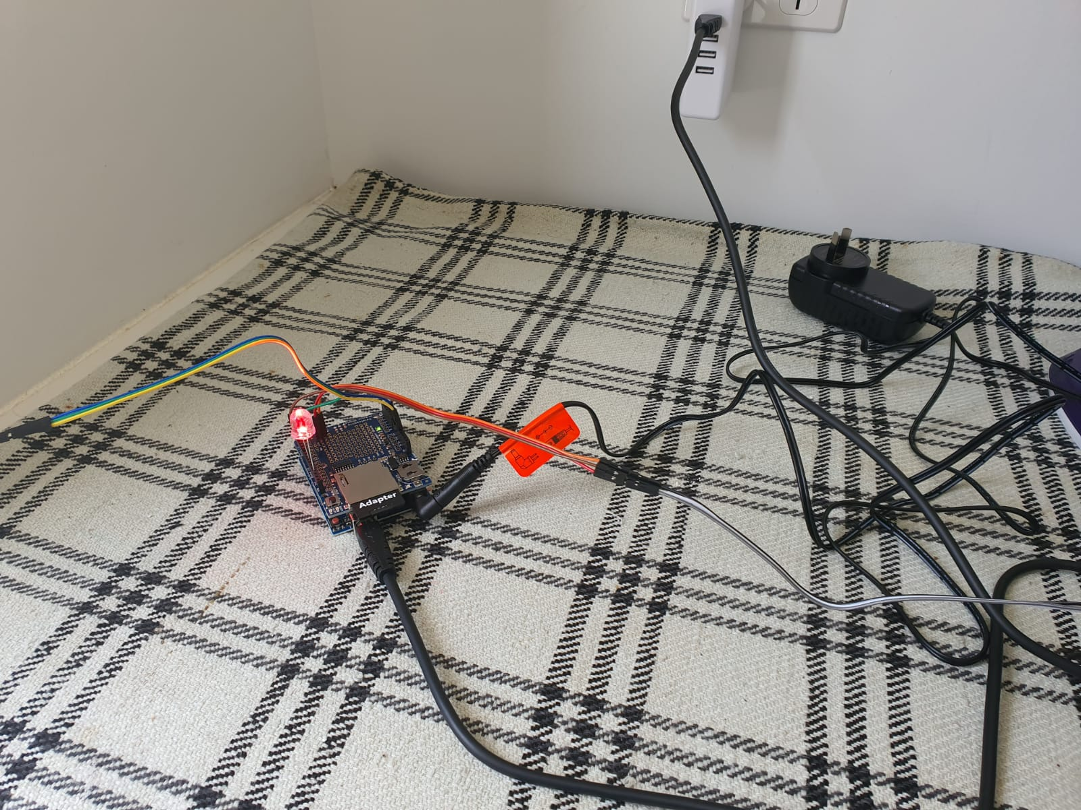
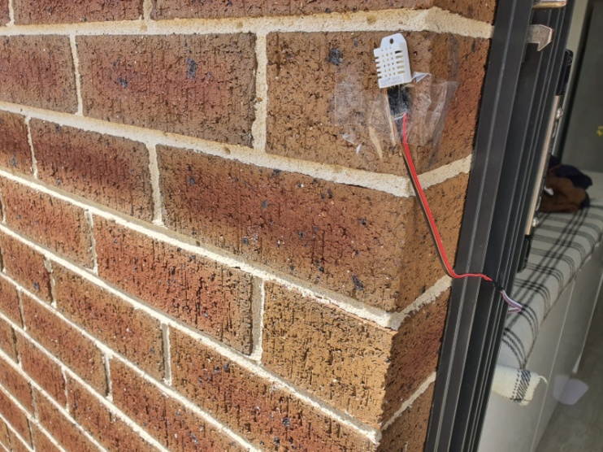
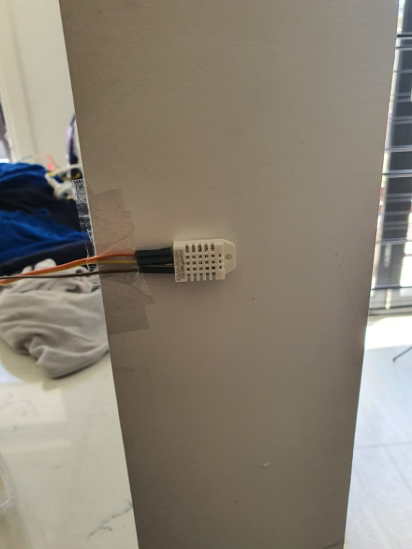
Photos of the system

Slide 12
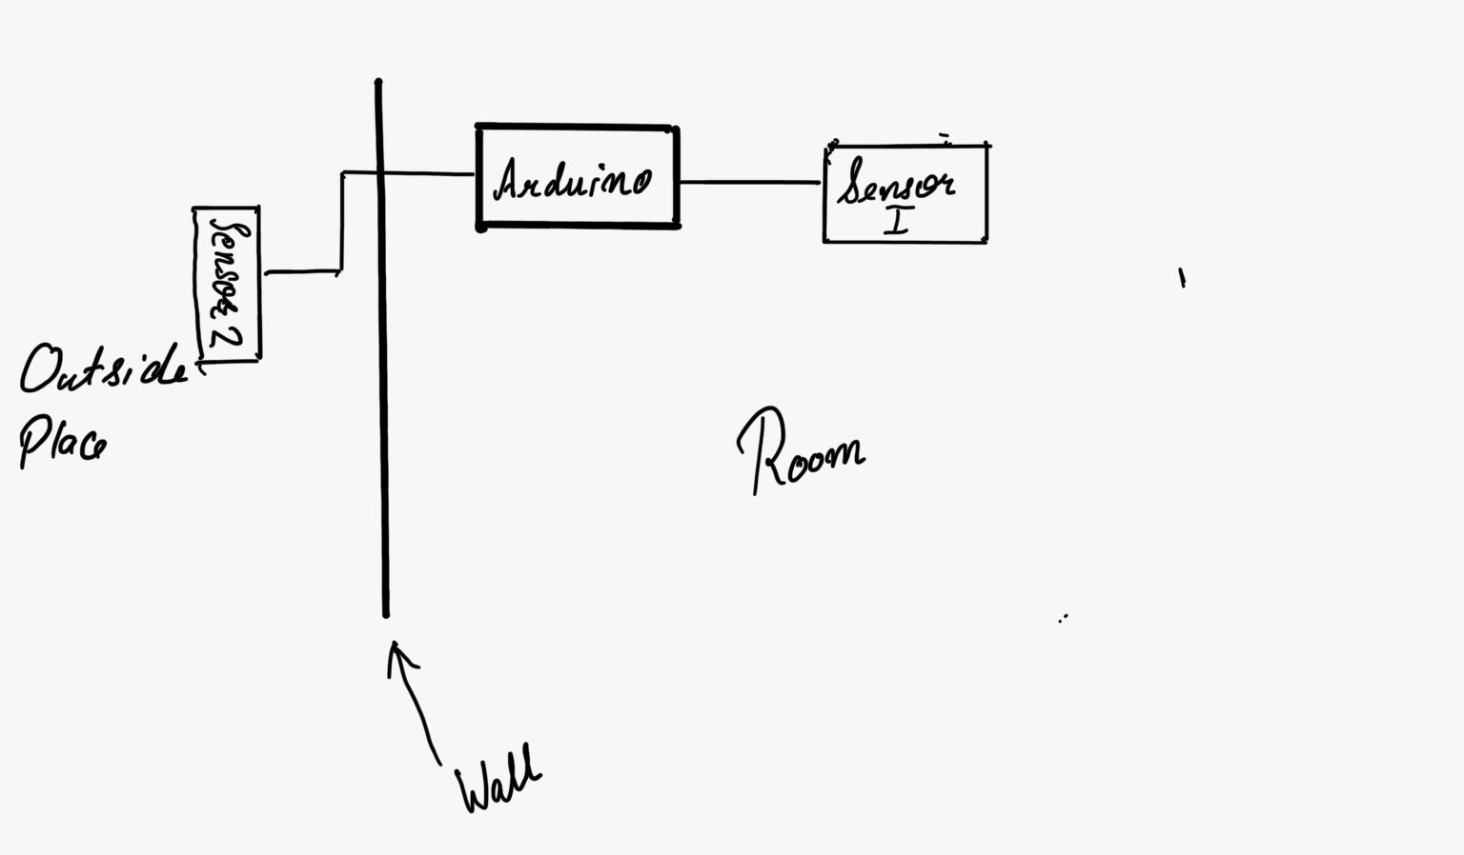
Diagram of the system

Slide 13
Challenges faced
Most difficult challenge face was how the comparison of both the datasets will be done.
Another challenge was that the stability and placing the outside sensor for the stability and durability.
Also, a challenge arise of the storing the data in which manner and the values required.

